Slide 1

Finding the hidden patterns of Dublin Airbnb Data using Regression Analysis.
X18110096
Khatik zainul abedin
Customer Relationship management
Guided by professor : vikas sahni

Slide 2
Objectives
1) Whether there is a relationship between the time since the host has rented out the space to Airbnb & review score rating, review per month.
2) What factors are to be considered to become a Super host.
3) Relationship between number of reviews & host response time, host response rate

Slide 3
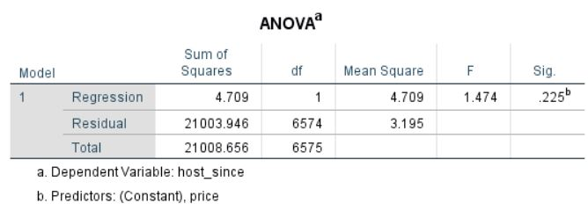
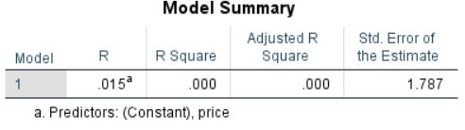
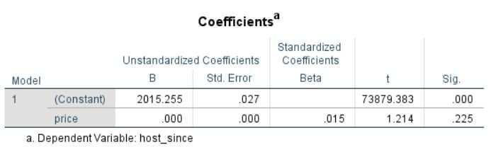

Since Host Vs Price
Linear Regression
Weak correlation between them
The price is effecting the since host by only 1.5%
The Anova table states that the significance level is not satisfied.
If sig value is less than 0.05 then the model is statistically true else it is not an accurate model.

Slide 4

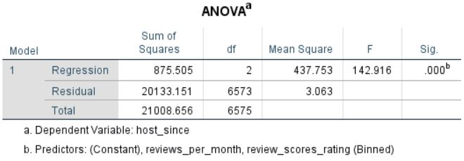
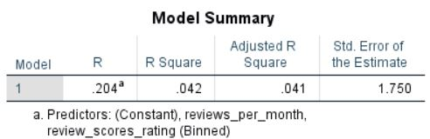
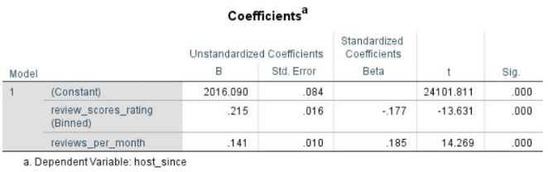
Whether there is relationship between the time since the host has rented out the space to Airbnb & reviews score rating, reviews per month
Multiple Regression
Multiple Regression is used
Dependent variables: Host Since
Independent variables: reviews score rating, reviews per month
The model summary table explains about the overall effect of the model on the host since i.e. 20.4%
The Anova table tells us that whether the model is statistically significant or not
Here value is less than 0.05 which satisfies the case
The coefficient table tells us the individual effect of review score rating and reviews per month effect on the host since.

Slide 5
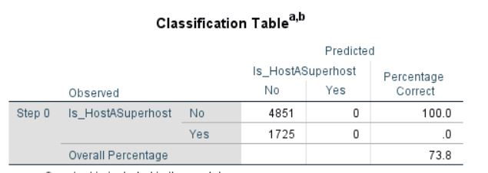
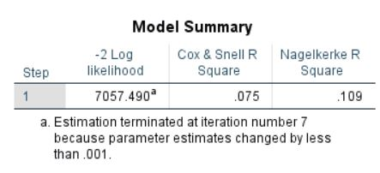
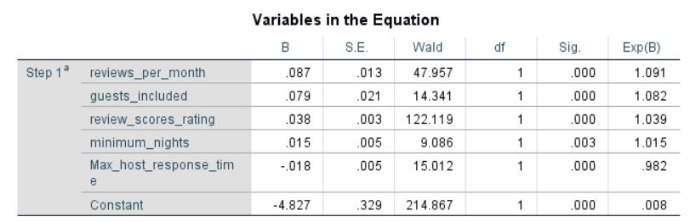
Factors to be considered to become Super host.
Logistic Regression
Logistic regression is used
Dependent Variable – Super host
Independent variables- reviews per month, guests included, reviews scores rating, minimum nights & max host response time
Classification table explains about the binary dependent variable. We found out that overall accuracy of model is 73.8%
Model summary table explains the test for significance which should be greater than 0.05(here it satisfies the condition)
Variables in the equation explains the individual independent variable effect on super host.(significance value should be less than 0.05)
Reviews per month has highest effect on Superhost

Slide 6
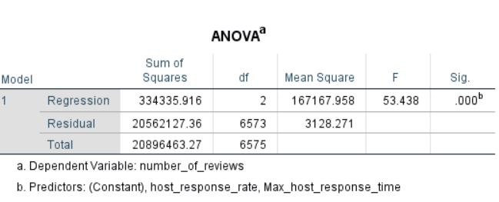
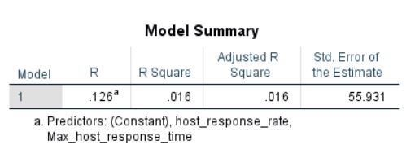
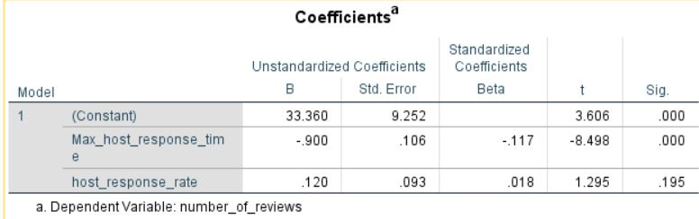
Relationship between number of reviews and host response time, host response rate?
Multiple Regression
Multiple Regression is used
Dependent variables: Number of reviews
Independent variables: max host response time and host response rate
The model summary table in this regression explains about the overall effect of the model on the Number of reviews i.e. 12.6%
The Anova table tells us that weather the model is statistically significant or not and if the value is less than 0.05 then it is significant and it is satisfied in this case.
The coefficient table says that the individually effect of max host response time and host response rate effect on the Number of reviews.

Slide 7
Thank You

